Slide 1

Student Details:
Name: DAREKAR SUSHANT SHAINATH
SkillsBuild Email Id: sushantdarekar2002@gmail.com
College Name: Bharati Vidyapeeth’s College of Engineering, lavale.
Aicte student id : STU64e444c300926169268141
Internship domain : Cyber Security
Internship start and End Date: (13 October 2023 – 26 November 2023)

Slide 2
Problem Statement :
Title: "Securing Digital Communication through Advanced Image Steganography"
Problem Statement:
In the era of increasing digital communication, ensuring the confidentiality and integrity of sensitive information is paramount. Traditional encryption methods provide a level of security, but they may not be sufficient to thwart sophisticated adversaries. This project aims to address this challenge by implementing advanced image steganography techniques to enhance the covert transmission of information within digital images.

Slide 3
AGENDA
Project Overview
Who are the End Users?
Your Solution and its Value Proposition
How did you customize the project and make it your own?
Modelling
Results
Links

Slide 4
Project Overview
Introduction:
In the contemporary digital landscape, securing sensitive information during communication is a critical concern. This project focuses on the development of an advanced image steganography system to enhance the security and confidentiality of digital data transmission. Image steganography involves the concealment of data within the pixels of an image, providing a covert communication channel that is resistant to detection.
Objectives:
Enhanced Data Security
Covert Communication
Detection Avoidance
User-Friendly Interface
Key Features:
Embedding Algorithm
Extraction Algorithm
Security Measures
Steganalysis Resistance

Slide 5
Who are the End Users?
The end users of an image steganography project can vary depending on the specific goals and design considerations of the project. Here are some potential end users for an image steganography project:
Military and Intelligence Agencies:
- Use Case: Covert communication in military operations and intelligence activities.
- Reason: Military and intelligence agencies often require secure and discreet communication channels for the exchange of sensitive information.
Corporate Organizations:
- Use Case: Secure communication of confidential business data.
- Reason: Companies dealing with proprietary information, trade secrets, or confidential client data may use steganography to enhance the security of their digital communication.
Government Agencies:
- Use Case: Secure communication within government departments.
- Reason: Government agencies handling classified information may employ steganography to add an extra layer of security to their communication protocols.
And many more…….

Slide 6
MY SOLUTION AND ITS VALUE PROPOSITION
Solution Overview:
The proposed image steganography project aims to provide a robust and advanced solution for securing digital communication through the concealment of information within images. This solution offers an innovative approach to data security, combining sophisticated steganography techniques with cryptographic measures to create a powerful tool for covert communication.
Key Features and Value Proposition:
1. Advanced Steganography Techniques:
- Value Proposition: The project incorporates state-of-the-art steganography algorithms that ensure the secure embedding of information within digital images. These advanced techniques go beyond basic hiding methods, making it difficult for unauthorized parties to detect the presence of concealed data.

Slide 7
Key Features and Value Proposition:
2. Cryptographic Security Measures:
- Value Proposition: To enhance overall security, the solution integrates cryptographic measures to protect the integrity and confidentiality of the concealed information. This ensures that even if the presence of steganography is suspected, the encrypted content remains secure.
3. User-Friendly Interface:
- Value Proposition: The project prioritizes user experience with an intuitive and user-friendly interface. This makes the technology accessible to a wide range of users, including those with limited technical expertise, fostering widespread adoption across different user groups.
4. Covert Communication Capabilities:
- Value Proposition: The solution facilitates covert communication by enabling users to embed and extract information within images seamlessly. This capability is particularly valuable in scenarios where discreet data exchange is crucial, such as military operations, intelligence activities, and confidential business communication.
5. Resistance to Detection:
- Value Proposition: The project employs advanced steganalysis-resistant methods, making it challenging for adversaries to detect the presence of hidden information. This resistance to detection enhances the effectiveness of the steganography system in the face of evolving security threats.

Slide 8
How did I customized the project
1. Modules:
-Tkinter, PIL, os, stegano
2. Security Measures:
- Integrate additional security measures based on the intended use of the steganography system. This could include strengthening cryptographic techniques, implementing access controls, or incorporating anti-tampering features.
- Customize security parameters, such as key lengths and encryption algorithms, to align with the desired security level.
3. User Interface Design:
-Uses Tkinter module of python for developing GUI of this Project
4. Integration of Additional Features:
-Select image from System
5. Platform Compatibility:
- Platform independent
6. Testing and Validation:
- Rigorously test the customized solution to ensure its reliability, security, and usability. This might involve using various datasets, conducting penetration testing, and gathering feedback from potential users.
- Iteratively refine the system based on testing results to enhance its overall performance.

Slide 9
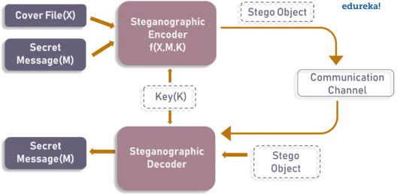
MODELLING

Slide 10
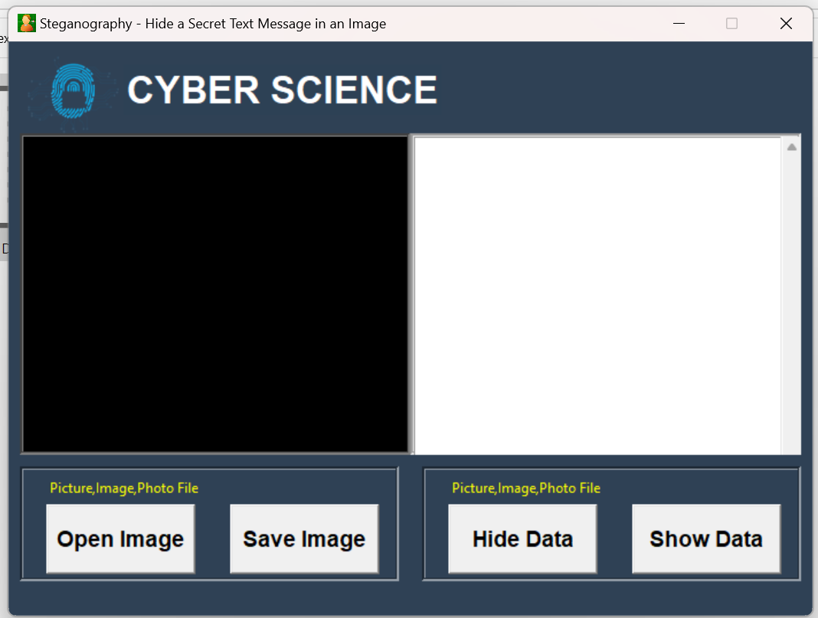
Results

Slide 11
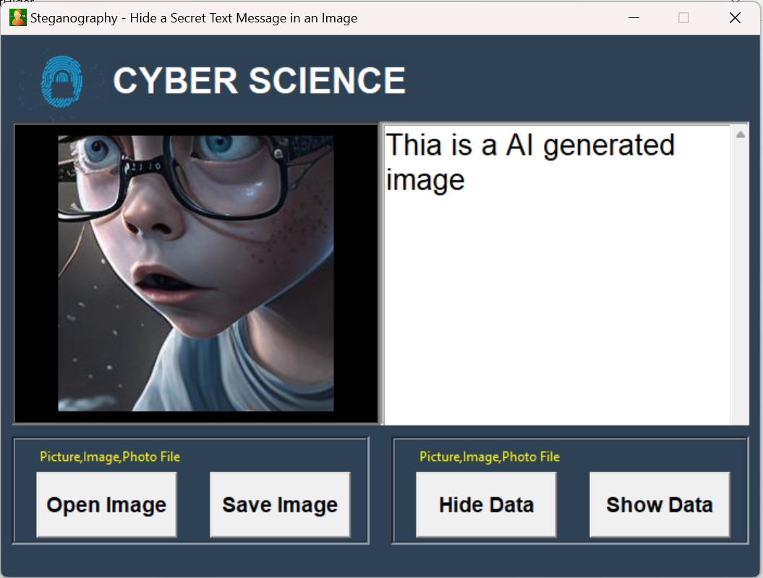
Results

Slide 12
Links :
https://github.com/Sushant-Darekar/Steganography_project.git

